Slide 1
영상정보처리 Lab 05
3*3Lowpass filtering, 5*5Lowpass filtering
Median filtering

Slide 2
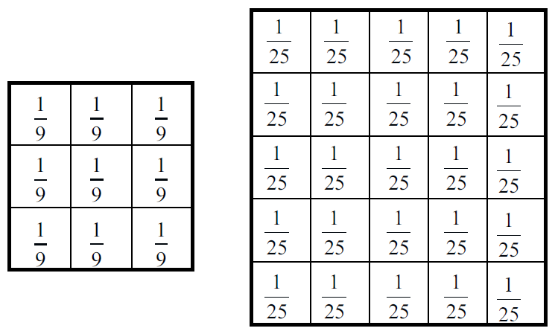
1. Lowpass filtering
3*3 lowpass filtering 을 위한 mask
5*5 lowpass filtering 을 위한 mask

Slide 3
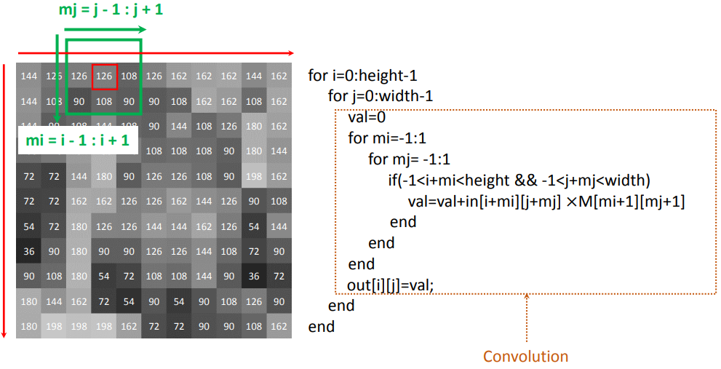
1. Lowpass filtering

Slide 4
1. Lowpass filtering
#1-1 3*3 Mask
Mat src, dst;
src = imread("Mandrill.bmp", IMREAD_COLOR); // Read the file
dst = Mat::zeros(src.size(), src.type());
double mask[3][3] = {/* values */};
#1-2 5*5 Mask
Mat src, dst;
src = imread("Mandrill.bmp", IMREAD_COLOR); // Read the file
dst = Mat::zeros(src.size(), src.type());
double mask[5][5] = {/* values */};

Slide 5
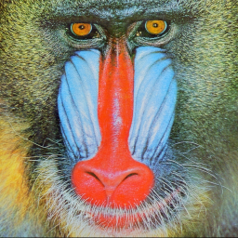

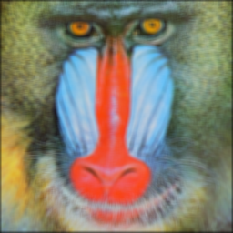
1. Lowpass filtering
Mandrill.bmp
Lowpass_filtering_3.bmp
Lowpass_filtering_5.bmp
원본
3*3 filtering
5*5 filtering

Slide 6
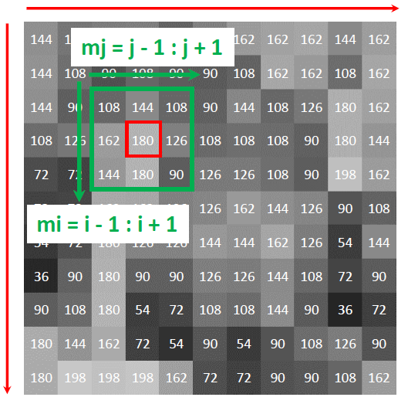
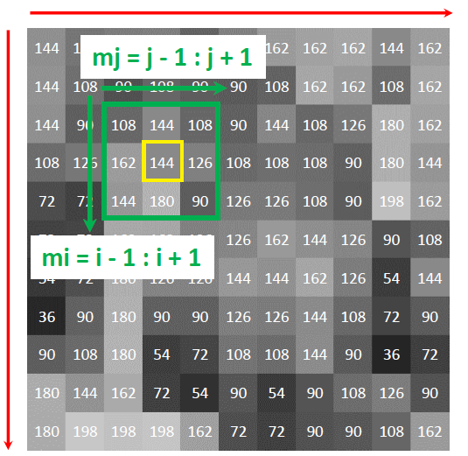

2. Median filtering
mask[9]
0 1 2 3 4 5 6 7 8

Slide 7
2. Median filtering
#2-1 unsigned char
Mat src, dst;
src = imread(“pepper_noise.bmp", IMREAD_COLOR); // Read the file
dst = Mat::zeros(src.size(), src.type());
unsigned char mask[9];

Slide 8
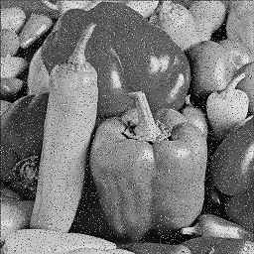
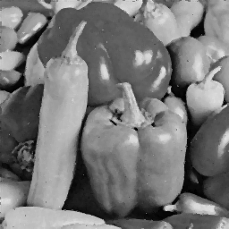
2. Median filtering
pepper_noise.bmp
median_filtering.bmp
원본영상
결과영상

